Slide 1
Software Engineering
FAST-NU

Slide 2
Architectural Styles

Slide 3
Architectural Styles
The architectural model of a system may conform to a generic architectural model or style
An awareness of these styles can simplify the problem of defining system architectures

Slide 4
Architectural Styles
Each style describes a system category that encompasses:
A set of components (e.g. database, computational modules) that perform a function required by a system
A set of connectors that enable “communication, coordination and cooperation” among components
Constraints that define how components can be integrated to form the system

Slide 5
Categories of Architectural Styles
Hierarchal Software Architecture
Layered
Distributed Software Architecture
Client Server
SOA
Data Flow Software Architecture
Pipe n Filter
Batch Sequential
Event Based Software Architecture
Data Centered Software Architecture
Black board
Shared Repository
Interaction-Oriented Software Architectures
Model View Controller
Component-Based Software Architecture

Slide 6
Hierarchal Software Architecture

Slide 7
Hierarchal Style
The hierarchical software architecture is characterized by viewing the entire system as a hierarchy structure.
The software system is decomposed into logical modules (subsystems) at different levels in the hierarchy.

Slide 8
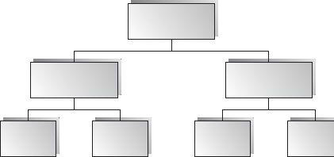
Hierarchal Style
Modules at different levels are connected by explicit or implicit method invocations.
a lower-level module provides services to its adjacent upper-level modules, which invokes the methods or procedures in the lower level.

Slide 9
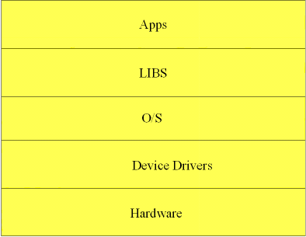
Hierarchal Style
System software is typically designed using the hierarchical architecture style;
examples include Microsoft .NET, Unix operating system, TCP/IP, etc.

Slide 10
Hierarchal Style
Lower levels provide more specific functionality down to fundamental utility services
such as I/O services, transaction, scheduling, and security services, etc.
Middle layers, in an application setting, provide more domain- dependent functions
such as business logic or core processing services.
Upper layers provide more abstract functionality in the form of user interfaces
such as command line interpreters, GUIs, Shell programming facilities, etc.

Slide 11
Layered Architecture

Slide 12
Layered Style
Organized hierarchically into layers.
Each layer provides service to the layer above it and serves as a client to the layer below.
The connectors are defined by the protocols that determine how the layers will interact.

Slide 13
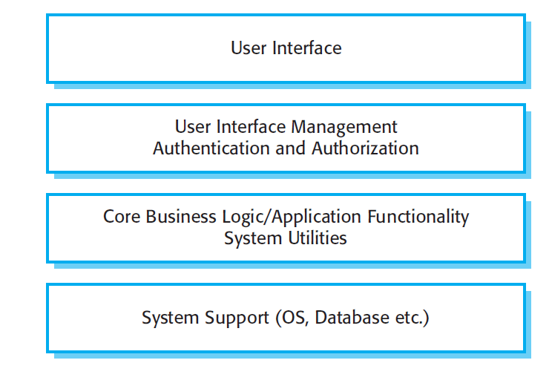
A generic Layered Architecture

Slide 14
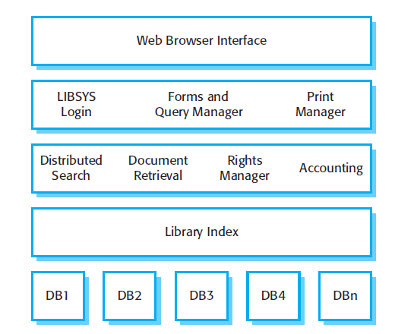
Example: Library System
Ref: Software Engineering - Sommerville

Slide 15
Benefits:
Incremental software development based on increasing levels of abstraction.
Enhanced independence of upper layer to lower layer since there is no impact from the changes of lower layer services as long as their interfaces remain unchanged.
Enhanced flexibility: interchangeability and reusability are enhanced due to the separation of the standard interface and its implementation.

Slide 16
Benefits:
Component-based technology is a suitable technology to implement layered architecture; this makes it much easier for the system to allow for plug-and-play of new components.
Promotion of portability: each layer can be an abstract machine deployed independently.

Slide 17
Limitations:
Lower runtime performance since a client's request or a response to a client must go through potentially several layers.
There are also performance concerns of data processing and buffering by each layer.
Breach of interlayer communication may cause deadlocks
Exceptions and error handling are issues in the layered architecture, since faults in one layer must propagate upward to all calling layers.

Slide 18
Distributed Software Architecture

Slide 19
Distributed Software Architecture
A distributed system is a collection of computational and storage devices connected through a communications network.
Data, software, and users are distributed.
Communication occurs using a number of methods including message passing, remote procedure calls, and remote method invocation.

Slide 20
Client Server Architectural Style

Slide 21
Client Server Architectural Style
Client/server architecture illustrates the relationship between two computer programs in which one program is a client, and the other is Server.
Client makes a service request to server.
Server provides service to the request.

Slide 22
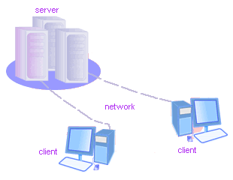
Client/Server
Although the client/server architecture can be used within a single computer by programs, but it is a more important idea in a network.
In a network, the client/server architecture allows efficient way to interconnect programs that are distributed efficiently across different locations.

Slide 23
Client-server Style
Suitable for applications that involve distributed data and processing across a range of components.
Components:
Servers: Stand-alone components that provide specific services such as printing, data management, etc.
Clients: Components that call on the services provided by servers.
Connector: The network, which allows clients to access remote servers.

Slide 24
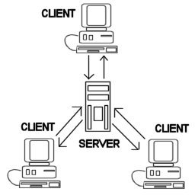
Common Example
The World Wide Web is an example of client-server architecture.
Each computer that uses a Web browser is a client, and the data on the various Web pages that those clients access is stored on multiple servers.

Slide 25
Another Example
If you have to check a bank account from your computer, you have to send a request to a server program at the bank.
That program processes the request and forwards the request to its own client program that sends a request to a database server at another bank computer to retrieve client balance information.
The balance is sent back to the bank data client, which in turn serves it back to your personal computer, which displays the information of balance on your computer.

Slide 26
Example:
Gmail
Picassa photoviewer
Drop box

Slide 27
Severs
Servers commonly contain data files and applications that can be accessed across the network, by workstations or user computers.
A user who wants to access data files, would use his or her client computer to access the data files on the server.

Slide 28
Types Of Servers
Application Servers:
Applications are hosted on these servers
Clients can access various application features over the network
Cricinfo, results from university website

Slide 29
Types Of Servers
File Servers:
Primitive form of data service.
Useful for sharing files across a network.
The client passes requests for files over the network to the file server.
Those file which We create with other software
Facebook save ours pictures,videos,
Different servers save our complete files

Slide 30
Types Of Servers
Database Servers:
More efficient use of distributing power than file servers.
Client passes SQL requests as messages to the DB server; results are returned over the network to the client.
Query processing done by the server.
No need for large data transfers.

Slide 31
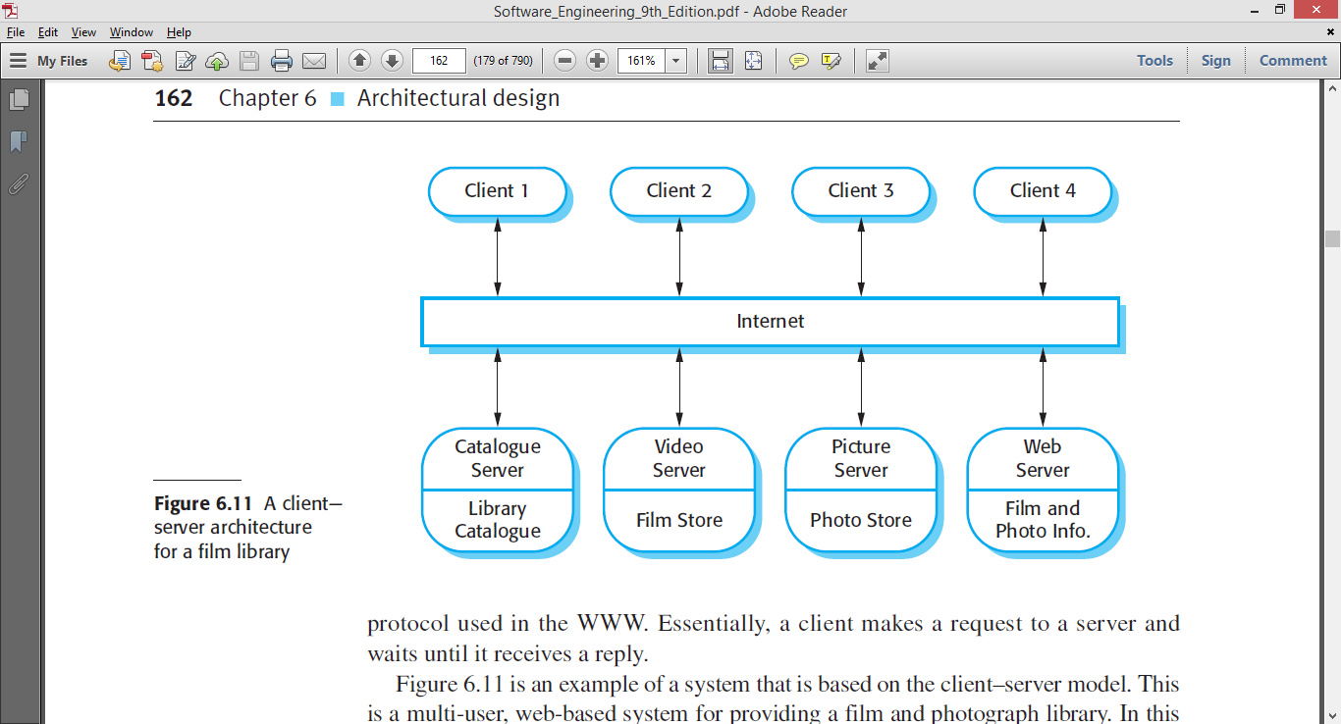

Slide 32
Advantages
Straightforward distribution of data.
Transparency of location.
Mix and match heterogeneous platforms
Easy to add new servers or upgrade existing servers.

Slide 33
Disadvantages
Performance of the system depends on the performance of the network.
Tricky to design and implement C/S systems.
Unless there is a central register of names and services, it may be hard to find out what services are available.

Slide 34
Multi-tier Client Server Architecture

Slide 35
Types Of Client Server
Two-tier client–server architecture
which is used for simple client–server systems, and in situations where it is important to centralize the system for security reasons.
In such cases, communication between the client and server is normally encrypted.
Multitier client–server architecture
which is used when there is a high volume of transactions to be processed by the server.
Notes:
online ticket reservations program, in which 2-tier architecture is used

Slide 36
A Two-tier Client–server Architecture
The system is implemented as a single logical server plus an indefinite number of clients that use that server.
Two forms of this architectural model:
A thin-client model,
A fat-client model,

Slide 37
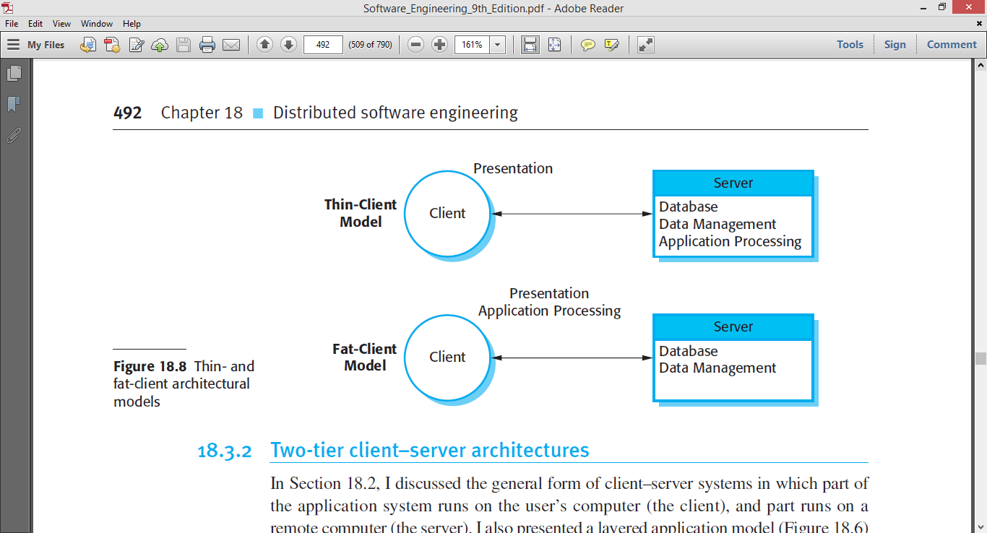
Two-tier Client Server
A thin-client model,
where the presentation layer is implemented on the client and all other layers (data management, application processing, and database) are implemented on a server.
Notes:
Google's Chrome OS is one current example of a browser-based thin client, where the client contains just enough code to run the browser and any minor maintenance required

Slide 38
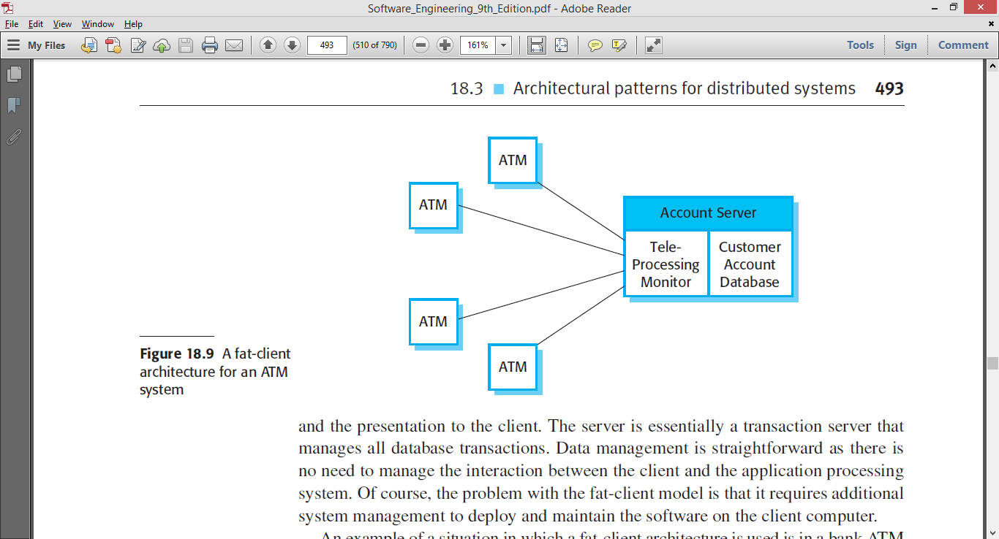
Two-tier Client Server
A fat-client model
where some or all of the application processing is carried out on the client.
Data management and database functions are implemented on the server.
Notes:
An example of a fat client is a client PC that is equipped with lots of RAM, a large hard disk, a fast processor, and perhaps a speedy DVD drive.

Slide 39
Multi-tier Client–server Architectures
The fundamental problem with a two-tier client–server approach is that the logical layers in the system—presentation, application processing, data management, and database—must be mapped onto two computer systems: the client and the server.
This may lead to problems with scalability and performance if the thin-client model is chosen, or problems of system management if the fat-client model is used.

Slide 40
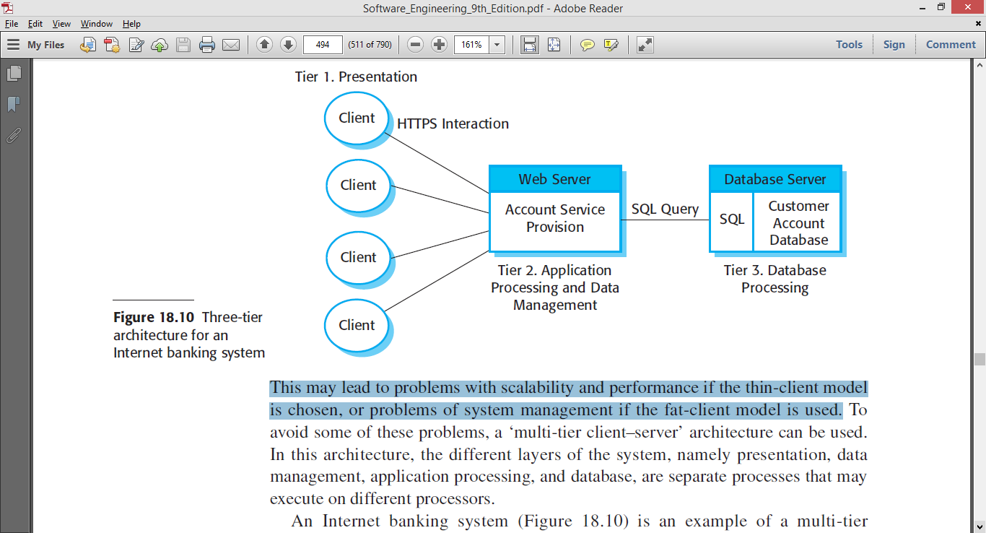
Application services such as facilities to transfer cash, generate statements, pay bills, and so on are implemented in the web server and as scripts that are executed by the client

Slide 41
This system is scalable because it is relatively easy to add servers (scale out) as the number of customers increase.
In this case, the use of a three-tier architecture allows the information transfer between the web server and the database server to be optimized.

Slide 42
Issues
Security for each server
Banking System-> need security but they have to handle their maximum users also

Slide 43
Shared Data Software Architecture

Slide 44
Shared Data Software Architecture
Data-centered software architecture is characterized by a centralized data store that is shared by all surrounding software components.
The software system is decomposed into two major partitions: data store and independent software component or agents.

Slide 45
Shared Data Software Architecture
In pure data-centered software architecture, the software components don't communicate with each other directly; instead, all the communication is conducted via the data store.
The shared data module provides all mechanisms for software components to access it, such as insertion, deletion, update, and retrieval.

Slide 46
Shared Data:
The high-level design solution is based on a shared data-store which acts as the “central command” with 2 variations:
Blackboard style
Repository style

Slide 47
Repository architecture

Slide 48
Repository Architecture
The repository architecture style is a data-centered architecture that supports user interaction for data processing.
The software component agents of the data store control the computation and flow of logic of the system.

Slide 49
Repository architecture
All data in a system is managed in a central repository that is accessible to all system components.
Components do not interact directly, only through the repository.
Lab testing
physician
diagnosis
Patient
database
accounting
& administration
pharmacy &
drug processing

Slide 50
Repository architecture
Organizing tools around a repository is an efficient way to share large amounts of data.
There is no need to transmit data explicitly from one component to another.

Slide 51
Repository architecture
However, components must operate around an agreed repository data model.
Inevitably, this is a compromise between the specific needs of each tool and it may be difficult or impossible to integrate new components if their data models do not fit the agreed schema.

Slide 52
Repository architecture
Although it is possible to distribute a logically centralized repository, there may be problems with data redundancy and inconsistency.
In practice, it may be difficult to distribute the repository over a number of machines.

Slide 53
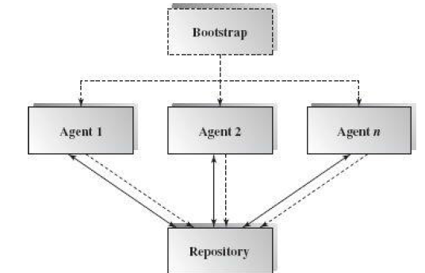
Repository Architecture
A general picture of the repository architecture.
The dashed lines pointing toward repository indicate that repository clients have full control over the logic flow.

Slide 54
Repository Architecture
Clients can get data from the data store and put data in the data store.
Different clients may have different interfaces and different data access privileges.

Slide 55
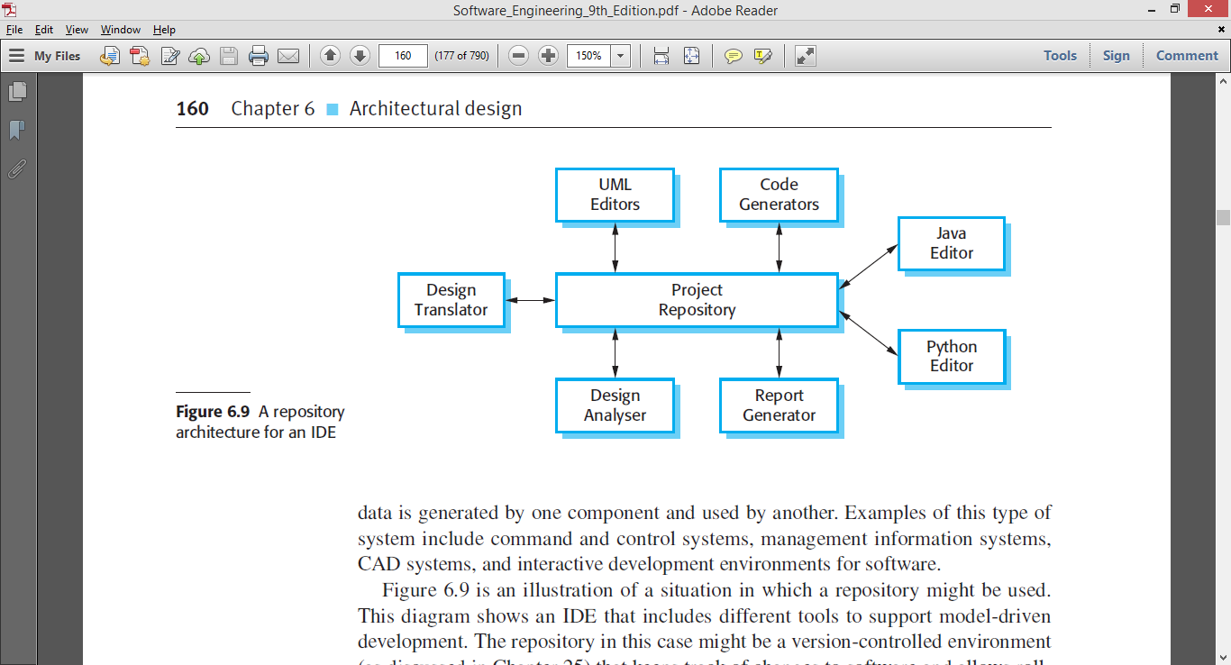
Example: Integrated Development Environment

Slide 56
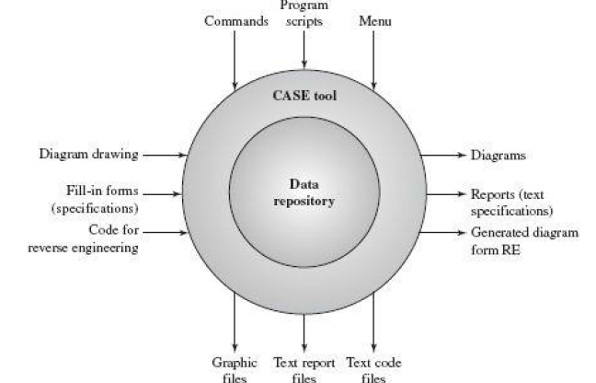
CASE Tools
There are many CASE tools surrounding the data store

Slide 57
CASE tools
A user of CASE tools can draw a UML design diagram such as a class diagram, collaboration diagram, or sequence diagram, and store the design blueprints in the CASE data store.
The biggest advantage of CASE tools is its centralized data with many supporting software tools which can generate different products for different purposes based on the same set of data.

Slide 58
Applicable domains of repository architecture:
Suitable for large, complex information systems where many software component clients need to access them in different ways
Requires data transactions to drive the control flow of computation

Slide 59
Advantages
Efficient way to share large amount of data
Sub-systems need not be concerns with how data is produced ( Centralized management). E.g. backup, security, etc.
Components can be independent—they do not need to know of the existence of other components.
Changes made by one component can be propagated to all components.

Slide 60
Disadvantages
The repository is a single point of failure so problems in the repository affect the whole system.
Data evolution is difficult and expensive.
May be inefficiencies in organizing all communication through the repository.
Distributing the repository across several computers may be difficult.

Slide 61
Data Flow Software Architecture

Slide 62
Data Flow Architectures
The data flow software architecture style views the entire software system as a series of transformations on successive sets of data, where data and operations on it are independent of each other.
The software system is decomposed into data processing elements where data directs and controls the order of data computation processing.
Each component in this architecture transforms its input data into corresponding output data.

Slide 63
Data Flow Architectures
Regardless of the type of topology, the data moves from one subsystem to another.
In general, there is no interaction between the modules except for the output and the input data connections between subsystems.

Slide 64
Data Flow Architectures
One subsystem can be substituted by another without affecting the rest of the system
Since each subsystem does not need to know the identity of any other subsystem, modifiability and reusability are important property attributes of the data flow architecture.

Slide 65
Pipes-and-Filters Style

Slide 66
Pipe and Filter
This architecture decomposes the whole system into components of data source, filters, pipes.
The connections between components are data streams.
The particular property attribute of the pipe and filter architecture is its concurrent and incremented execution.

Slide 67
Pipes-and-Filters Style
Suitable for applications that require a defined series of independent computations to be performed on data.
Each component has a set of inputs and set of outputs.
A component reads a stream of data on its input and produces stream of data at its output.

Slide 68
Filter
Each filter is an independent data stream transformer;
it reads data from its input data stream, transforms and processes it, and then
writes the transformed data stream over a pipe for the next filter to process.

Slide 69
Filter
A filter does not need to wait for batched data as a whole.
As soon as the data arrives through the connected pipe, the filter can start working right away.
A filter does not even know the identity of data upstream or data downstream.
A filter is just working in a local incremental mode.

Slide 70
Pipes
The connectors serve as channels for the streams, transmitting outputs of one filter to inputs of the other.
This makes connectors act as Pipes.

Slide 71
Pipes
A pipe moves a data stream from one filter to another.
A pipe can carry binary or character streams.
A pipe is placed between two filters; these filters can run in separate threads of the same process.

Slide 72

Structure

Slide 73
There are three ways to make the data flow:
Push only (Write only)
A data source may push data in a downstream.
A filter may push data in a downstream.
Pull only (Read only)
A data sink may pull data from an upstream.
A filter may pull data from an upstream.
Pull/Push (Read/Write)
A filter may pull data from an upstream and push transformed data in a downstream.

Slide 74
Examples
Traditional Compilers:
Compilation phases are pipelined, though the phases are not always incremental. The phases in the pipeline include:
lexical analysis + syntax analysis (parsing) + semantic analysis + code optimization + code generation

Slide 75
Example: Architecture of a Compiler
Compilation is regarded as a sequential (pipeline) process.
Every phase is dependent on some data on the preceding phase.
text
Lex
Syn
Sem
Opt
CGen
code

Slide 76
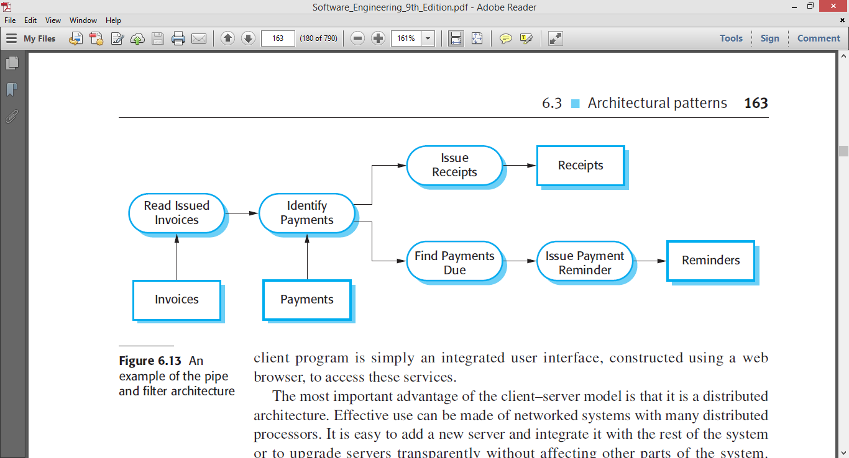
Sales System

Slide 77
Applicable domains of pipe and filter architecture:
The system can be broken into a series of processing steps over data streams, and at each step filters consume and move data incrementally.
The data format on the data streams is simple, stable, and adaptable if necessary.
Significant work can be pipelined to gain increased performance.
Producer or consumer-related problems are being addressed.

Slide 78
Benefits:
Concurrency: It provides high overall throughput for excessive data processing.
Reusability: Encapsulation of filters makes it easy to plug and play, and to substitute.
Flexibility: It supports both sequential and parallel execution.

Slide 79
Benefits:
Modifiability: It features low coupling between filters, less impact from adding new filters, and modifying the implementation of any existing filters as long as the I/O interfaces are unchanged.
Simplicity: It offers clear division between any two filters connected by a pipe.

Slide 80
Disadvantages
Not good choice for interactive systems, because of their transformational characteristic.

